Slide 1






Generative Al applications on education

Slide 2






Project Introduction
Nowadays, students' demand for knowledge acquisition is increasing, and educators need better tools to meet their needs.
Traditional teaching methods often fail to meet the requirements of personalized learning, and our AI question-answering system will fill this gap.
Notes:
Our project is about "Generative Al applications on education".
Students want to learn more these days, and teachers need better ways to help them.
Old ways of teaching don't always work for everyone.
So, we made an AI system that answers questions, called ChatVideo.

Slide 3
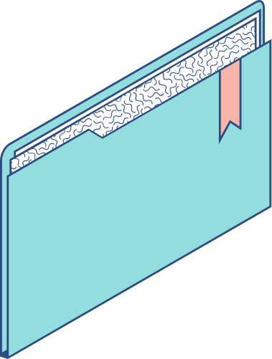
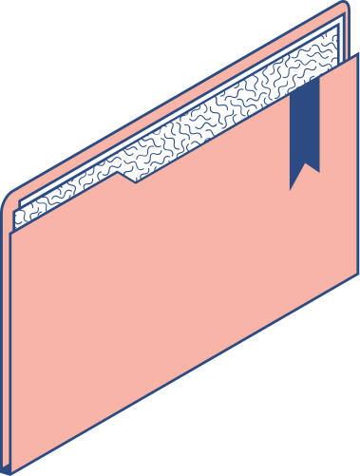

Technical Background
This project involves the following technologies: Clustering Models: K-Means Clustering, DBSCAN GPT Model Similar Vector Retrieval Langchain Retrieval-Augmented Generation (RAG)
Notes:
This project uses some cool technology.
The main thing is ChatGPT, which helps understand and process info.
We also use Clustering Models, like K-Means Clustering and DBSCAN, to find similar questions in a bunch of user queries.
Then there's Similar Vector Retrieval, which finds items in a big dataset that match a query.
Langchain helps us add large language models to our system, making our chat systems and text processing better.
Lastly, RAG combines finding info and making text. This helps create better responses by using info from lots of data, which is really important for the chat part of our project.

Slide 4

System Design
&
Implementation
Notes:
Now let me introduce the Design of the system

Slide 5
SYSTEM DESIGN & IMPLEMENTATION
Algorithm Design：Summary
Approach 1: Summarizing only the beginning of each paragraph
1
2
3
STEP
STEP
STEP
the text is evenly divided into several paragraphs.
Extract the first 400 words from each paragraph, resulting in a cumulative summary of 4,000 words.
These summary contents are then used for further processing and analysis with the GPT model.
Notes:
In our system, we have a cool way to make "short summary" of video chats.
Here's how one method works. We break the chat into parts, like if there's a really long,
like one million words
we make 10 parts of 1,000 words each.
Then, from each part, we only take the first 400 words.
So, we end up with a shorter version of 4,000 words that still has all the main points.
This summary is then send to the chatgpt to make it better.
It's a smart and quick way to get the summary of long chats!

Slide 6
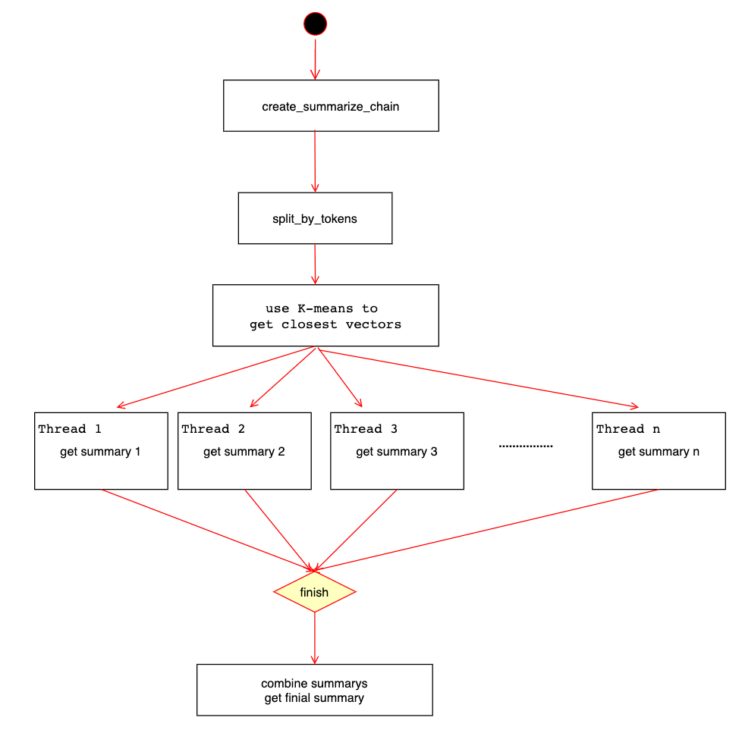
SYSTEM DESIGN & IMPLEMENTATION
Algorithm Design：Summary
Approach 2: Hierarchical Summary
Notes:
In Approach 1, breaking the text into 10 parts without going over 4,000 words each was tough.
Using just the first 400 words from each part didn't work;
cause, too much important info was lost.
So, I switched Approach.
Now, I summarize each paragraph separately and then combine them.
After that, I do a big summary of all these little ones, keeping the main points but making it short.
If it's still too long, I'll do more rounds of summarizing.
To make sure each summary is clear and complete, I use cool techniques from question-answering algorithms, like breaking down sentences and filling in gaps, which helps keep the original meaning and flow.

Slide 7
SYSTEM DESIGN & IMPLEMENTATION
Algorithm Design：Summary
You will be given a single section from a text.
This will be enclosed in triple backticks.
Please provide a cohesive summary of the following section excerpt,
focusing on the key points and main ideas, while maintaining clarity and conciseness.
<text>{text}</text>
Map prompt: This prompt asks GPT to summarize a paragraph, focusing on the key points and main ideas.
Notes:
Here's the prompt I use
this summary one paragraph.

Slide 8
SYSTEM DESIGN & IMPLEMENTATION
Algorithm Design：Summary
Read all the provided summaries from a larger document.
They will be enclosed in triple backticks.
Determine what the overall document is about and summarize it with this information in mind.
Synthesize the info into a well-formatted easy-to-read synopsis, structured like an essay that summarizes them cohesively.
Do not simply reword the provided text.
Do not copy the structure from the provided text.
Avoid repetition. Connect all the ideas together.
Preceding the synopsis, write a short, bullet form list of key takeaways.
Format in HTML.
Text should be divided into paragraphs. Paragraphs should be indented.
<text>{text}</text>
Reduce prompt: The task of this prompt is to summarize multiple summaries.
Notes:
this mix all these summaries into one.

Slide 9

SYSTEM DESIGN & IMPLEMENTATION
Algorithm Design：Summary
Approach 1: Summarizing only the beginning of each paragraph
Approach 2: Hierarchical Summary
Notes:
when I looked at two ways to summarize, I noticed they're different.
The first way just takes the start of each paragraph.
It's cheap, quick, and touches on everything a bit.
But it might skip important stuff, especially in long texts.
The second way, really digs deep into the whole text.
This means you get a better, more complete summary without missing big points.
But, it's slower, and sometimes you might not get the full picture.
So, when picking the best way, think about cost, speed, how accurate it is, and if it all makes sense together.

Slide 10

Algorithm Optimization
Notes:
I also doing some Optimization

Slide 11

SYSTEM DESIGN & IMPLEMENTATION
Algorithm Design：Summary
Algorithm Optimization: Refine
To address the issue of lack of context mentioned earlier： The algorithm steps for this method are as follows: Summarize the first paragraph of the document. Combine this summary with the original text of the second paragraph and submit it to GPT for a secondary summary. Combine the newly generated summary with the next paragraph of text and request another summary from GPT.
Notes:
First is the "Refine" method.
This is to fix the problem where there's not enough context given before.
Here's how the algorithm works:
1. Take the first paragraph of a document and make a short summary of it.
2. Next, mix this summary with the full text of the second paragraph and get GPT to summarize it again.
3. Then, take this new summary and add it to the following paragraph's text. Ask GPT for another summary.
By doing this, GPT gets to look back at what was said earlier, which helps a lot with the context problem.

Slide 12

SYSTEM DESIGN & IMPLEMENTATION
Algorithm Design：Summary
Algorithm Optimization: Paragraph Clustering Using K-means
When dealing with long texts, I used an optimization strategy to reduce computational costs and improve processing speed. The algorithm steps for this method are as follows: Split the long text into multiple paragraphs. Cluster these paragraphs, grouping together those with similar content. Identify the most representative paragraph in each class, which is the vector closest to the class center. Utilize the most representative paragraphs in each category for mapreduce operations.
Notes:
Next I'll talk about paragraphs clustering using K-means.
So, when I'm working with really long texts, I use a trick to make things faster.
This trick is first clustering the paragraphs using k-means algorithm before I do the summary.
This way of doing it, really speeds things up,
but it's not perfect because some details might get lost.
Here's how it works:
I break the long text into several paragraphs.
Then, I clustering these paragraphs based on what they're about.
Like, if I have 300 paragraphs, I use the k-means algorithm to put them into different groups based on similar topics.
After that, in each group, I find the paragraph that best represents that group.
This paragraph is the one that's closest to the middle of the group.
Finally, I use these key paragraphs from each group for hi ri artical summary.
The goal is to handle long texts efficiently but still keep a good level of accuracy.

Slide 13
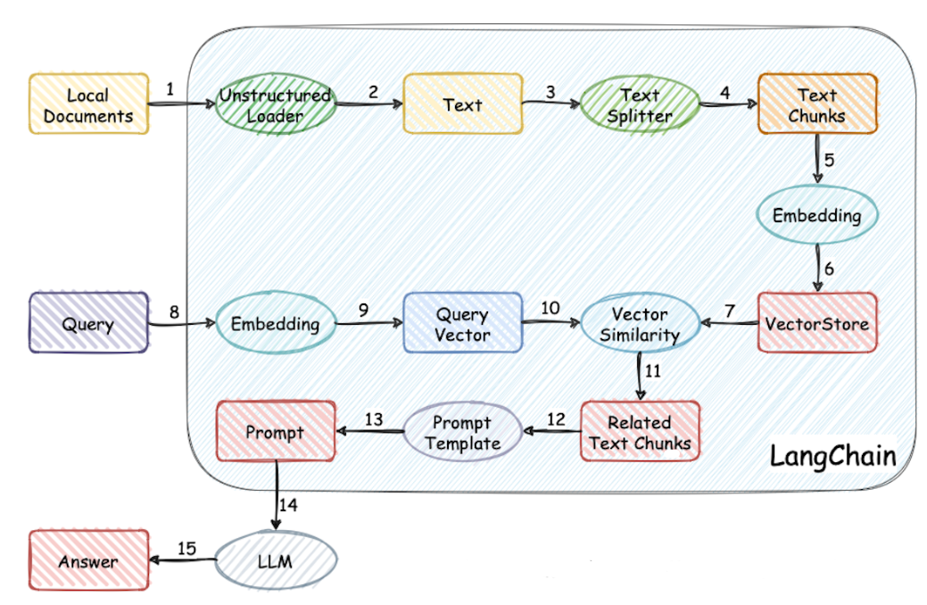
SYSTEM DESIGN & IMPLEMENTATION
Algorithm Design：LLM + Approximate Vector Matching
Notes:
let’s move to LLM + Approximate Vector Matching
The "chat with video" and "video retrieval" features in system both use this.
- here is how it work:
First, the system get transcript from a video.
It then breaks these into smaller parts.
This could be based on the number of characters, how long they are, or their meaning.
This step is important because the chatgpt can't take in too much text at once.
So, we pick out the key parts of the transcript that are useful for answering the user's questions.
When someone asks a question, this method turns the question into a vector.
Then, it uses Approximate Vector Matching to find parts of the transcript that match this vector.
In simple terms, it looks for the transcript parts that are most similar to the question.
Next, the system takes these matching transcript parts and user query. feeds them to chatgpt.
the chatgpt then generates answers that are accurate and relevant to the question.
So, that's how it works!

Slide 14
SYSTEM DESIGN & IMPLEMENTATION
Algorithm Design：LLM + Search Engine
1
2
STEP
STEP
Retrieving User Questions using a Search Engine
Generating Q/A using LLM
Notes:
The "chat with video" feature in system also use “LLM + Search Engine”, which is pretty similar to “LLM + Approximate Vector Matching”.
But instead of just matching text with vectors, it uses stuff found by a search engine.
here is how it work:
First, it uses a search engine to find some web page relate to the user's query.
and then, The algorithm mixes what it found from the search engine with the user's original query.
This mix becomes a prompt for chatgpt.
chatgpt then takes this prompt, and answer user.

Slide 15
Algorithm Optimization
Notes:
Here is some Optimization I tried

Slide 16
SYSTEM DESIGN & IMPLEMENTATION
Algorithm Design：LLM + Approximate Vector Matching
Algorithm Optimization: Sentence Segmentation
Issue: When splitting text based on punctuation for text split, a sentence may be divided into two segments due to the length limitation of the embedding model. Optimization: In addition to the original splitting, if the length of the text after splitting exceeds the preset value for a single segment (OpenAI's embedding model has a length limit of 500, so the default is 500), further splitting is performed based on punctuation such as commas. This maximizes the length of the text while adhering to the embedding model's length limitation and minimizes errors in the understanding process of the embedding model.
Notes:
- Sometimes when we split text into parts,
using punctuation marks,
a long sentence may get cut in half.
This happens because chatgpt can only handle a certain length at a time.
- so, We're doing something extra, now.
If the piece of text we split off is still too long
we'll split it again, but this time using commas or similar punctuation.
This way, we can use as much of the text as possible without going over the limit, and the model can understand it better.

Slide 17
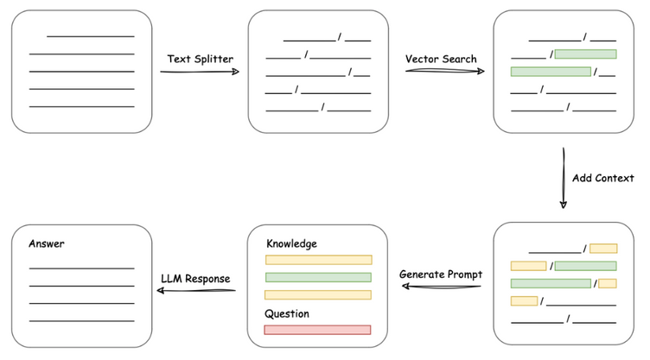
SYSTEM DESIGN & IMPLEMENTATION
Algorithm Design：LLM + Approximate Vector Matching
Algorithm Optimization: Context completion
Issue: When retrieving the most similar text to the user's question, the retrieved text may not express complete semantics due to the length limitation of the embedding model. Optimization: After retrieving the most similar texts, the content above and below the text is expanded to form a text that expresses relatively complete semantics.
Notes:
- Sometimes when finding text similar to a user's question,
we don't get the full meaning.
Like, we might just get a title, which isn't enough.
- So, after we find the closest matching texts, we also look at the content before and after them.
This way, we create a more complete and meaningful text.

Slide 18
SYSTEM DESIGN & IMPLEMENTATION
Algorithm Design：LLM + Approximate Vector Matching
Algorithm Optimization: Duplicate removal
Issue: Due to context completion, duplicate sentences may appear when retrieving the most similar text to the user's question, resulting in wasted token count. Optimization: Another round of duplicate removal is performed after context completion.
Notes:
- Sometimes when we find text that's really like what you asked,
we end up with the same sentences more than once.
This uses up space for no reason.
- So, we go through everything again after finishing up to make sure we take out any repeats.

Slide 19
SYSTEM DESIGN & IMPLEMENTATION
Algorithm Design：LLM + Approximate Vector Matching
Algorithm Optimization: Content retrieval
Issue: In conversations with LLM, sometimes the user's question does not express complete semantics and requires previous conversations to understand the complete meaning of the question. If the user's question is used for content retrieval directly, valid content cannot be retrieved. Optimization: Before content retrieval, the user's complete semantics are obtained by allowing chatgpt to answer using the previous conversation excerpts and the user's current question. The answer from chatgpt is transformed into a request with complete semantics by adding "Please provide an answer." Prompt: <instruction>Interpret the user's prompt in the 'prompt' section below referring to the previous conversation excerpts I provided. Don't answer the user's prompt! Directly and concisely state the interpretation of the user's prompt.</instruction> <prompt>{{ question }}</prompt>
Notes:
In a chat with model, sometimes your question may not have enough info.
It may need stuff, from earlier in the chat, to make sense.
For example, you might ask for an example or more details,
but without the full context, it's hard to know what you're talking about.
So, before retrieve the paragraph relate to user query,
the model looks at current query and also checks the earlier conversation.
This way, it gets the full picture, and can give you a better answer.

Slide 20
SYSTEM DESIGN & IMPLEMENTATION
Algorithm Design：LLM + Approximate Vector Matching
Algorithm Optimization: Previous content
Issue: LLM does not remember previous content in a conversation. Optimization: This issue is resolved by incorporating the user's question into a predefined prompt. The predefined prompt provides instructions to chatgpt to answer the user's current question with reference to the previous conversation. Prompt: <instruction>Provide a response to the user's prompt in the 'prompt' section below, utilizing the details in the 'info' section below and any relevant context from previous conversation excerpts. Ensure your answer is succinct and maintains a professional demeanor.- If the query is beyond the scope of available information, respond with: "Insufficient information to answer this query."- If the user's request is ambiguous or vague, request further details in a courteous manner.</instruction><info>{{ context }}</info><prompt>{{ question }}</prompt>
Notes:
- The chatgpt can't remember what was said earlier in the chat.
Like, if you ask, "What does something mentioned in the previous conversation means?"
- Now, this is fixed by including what you ask in a prompt.
This prompt tells the model to answer your question while thinking about what was talked about earlier.

Slide 21
SYSTEM DESIGN & IMPLEMENTATION
Algorithm Design：Clustering
1
2
STEP
STEP
Problem Collection
Clustering Problem
Notes:
the last one is Clustering. The statistical display section uses it.
it has two step Problem Collection and Clustering Problem.

Slide 22
Step 2
Clustering Problem
Traditional Clustering Algorithm：
1
2
3
4
STEP
STEP
STEP
STEP
Data Preprocessing
Text Vectorization
Selection and Implementation of Clustering Algorithm
Evaluation and Adjustment
Notes:
for Clustering Problem, there are two approach.
First is the Traditional Clustering Algorithm, and it has these steps:
1. Start by cleaning the text. Get rid of unnecessary characters, punctuation, and special symbols.
For Chinese text, break it down into words to find key words and phrases. Also, take out stop words to make the data clearer.
2. Use TF-IDF and OpenAI's model to turn text into vector.
3. Pick a clustering algorithm that fits your needs and the type of data you have, like k-means or DBSCAN.
4. Check how well your clustering worked

Slide 23
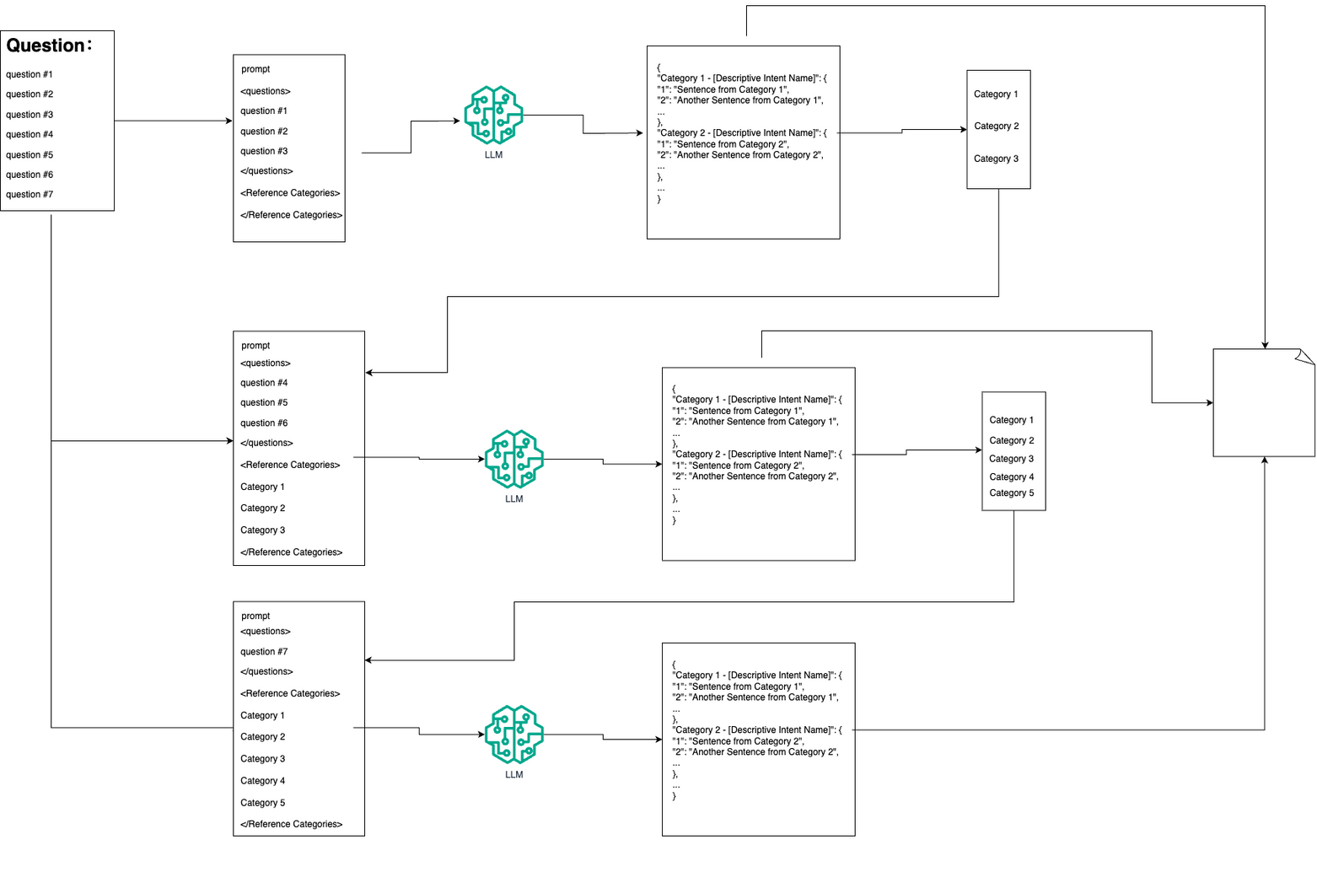
Step 2
Clustering Problem
Clustering based on chatgpt：
Notes:
next approach is Clustering based on chatgpt.
it consists of several steps:
1. First, we get ready. If we already have categories from past videos, we'll add them to our prompt.
If not, we'll leave it blank.
Then, we pick some questions from our big list of questions.
We gotta make sure they're not too long for ChatGPT to handle.
2. Next, we send this to ChatGPT.
It's going to give us back a answer in a format called JSON,
which basically sorts questions into different categories.
3. After that, we take these sorted questions and save them in their categories.
Some might go into categories we already have, and some might start new ones.
4. Then, we do it all over again. We take the categories we got, add them to prompt for the next round, grab some more questions, and ask ChatGPT again.
We keep doing this until we've gone through all our questions.

Slide 24
<instruction>
You are tasked with analyzing a collection of user queries extracted from a question database,
which are listed in the "Questions" section below. Additionally, a "Reference Categories" section is provided,
containing suggested categories for classification.
Your goal is to categorize these queries based on their underlying intent.
Ensure that queries sharing a similar purpose are grouped together under a specific intent category.
Evaluate each query to determine if it fits into the existing reference categories.
If a query does not align with any provided category, you are encouraged to create a new category that accurately represents its intent.
Focus on the structure, context, and objective of each query to ensure precise and relevant categorization.
</instruction>
<questions>{{ questions }}</questions>
<Reference Categories>{{ Reference Categories }}</Reference Categories>
Respond with your categorization in the following structured JSON format:
{
"Category 1 - [Descriptive Intent Name]": {
"1": "Sentence from Category 1",
"2": "Another Sentence from Category 1",
...
},
"Category 2 - [Descriptive Intent Name]": {
"1": "Sentence from Category 2",
"2": "Another Sentence from Category 2",
...
},
...
}
Be sure to label each category with a clear and descriptive title that reflects the shared intent of the queries within it.
Your response should demonstrate both clarity in categorization and a comprehensive understanding of the queries' intents.
Step 2
Clustering Problem
Prompt：
Notes:
Here is the prompt I use.

Slide 25
SYSTEM DESIGN & IMPLEMENTATION
Algorithm Design：Clustering
Approach 1: Traditional Clustering Algorithm
Approach 2: Clustering based on chatgpt
Notes:
I compared at two ways of grouping things and paid attention to how detailed, logical, and on-target they were.
Here's what I found:
The traditional way is more about putting things into big, general groups.
The way using chatgpt of grouping is better because it sorts things into really specific categories and makes sense logically.
It's great for dealing with lots of different things and gives you a more detailed breakdown.
So, the way using chatgpt is top-notch for finding exactly what you need on specific topics, while the traditional way gives you a big-picture view of creative models.
Also, the traditional way are quicker and use less stuff
the way using ChatGPT is slower and needs more resources.

Slide 26
Algorithm Optimization
Notes:
here is some Optimization

Slide 27
SYSTEM DESIGN & IMPLEMENTATION
Algorithm Design：Clustering
Algorithm Optimization: Optimization of Problem Collection Section
Problem: When collecting user problems, sometimes the users do not express their complete intentions in their questions. For example, users may ask "give me more explanation" without specifying the context. Additionally, sometimes the user's question itself does not have any intention. For example, users may say "well said" without a specific request. Collecting these types of questions is meaningless because we cannot determine the user's true intention from the question. It may even affect the final clustering results. Optimization: Before collecting user problems, obtain the complete semantics of the user by allowing chatgpt to determine if the user's question has a request. The user's request needs to be inserted into the "prompt" section. If the user's request is unclear or there is no specific request, chatgpt will respond with "***". If the user's request is clear, chatgpt will respond in the format "user's request: [Direct and concise statement of the user's request]".
Notes:
When we get questions from users, sometimes they don't fully say what they want.
Like, someone might ask for more details but not say about what.
Or, they might just say something like "good job" without actually asking anything.
It's pointless to collect these kinds of questions because we can't really tell what the user wants.
so, Before we record user problems, make sure we really get what the user means.
ChatGPT will check if there's a real question in what the user says.
The actual question should be put in the "prompt" part.
If the question isn't clear or there isn't really one, ChatGPT will just reply with a symble.
But if the question is clear, will recoed what the user's asking for.

Slide 28
SYSTEM DESIGN & IMPLEMENTATION
Algorithm Design：Clustering
Prompt：
<instruction> Refer to the user's query in the 'prompt' section below to give me the user’s request, not prompt's answer. - If the user's request is unclear or there are no request, Reply to me: "***". - If the user's request is clear, respond using the format: "user's request: [Directly and concisely state user’s request here]" </instruction> <prompt>{{ question }}</prompt>
Notes:
here is the prompt I use

Slide 29

System present time
Notes:
now let me show my system

Slide 30
Thanks！！！

